Slide 1

Steganography vs Cryptography: Hidden Security in the Digital World
CSA5111-CRYPTOGRAPHY AND NETWORK SECURITY
Presented by
R.Yoga Nandhini (192524101)

Slide 2


INTRODUCTION
Digital communication is widely used for sharing information.
Personal and confidential information must be protected from unauthorized access.
Cybersecurity provides methods to protect digital information.
Cryptography and steganography are two important information security techniques.
Cryptography protects the meaning of a message by converting it into an unreadable form.
Steganography protects information by hiding the message inside another file.
Both techniques help improve privacy and secure communication.
These techniques are used in different areas of digital security.
The choice of technique depends on the security requirements.
Understanding both methods helps us learn how digital information can be protected.

Slide 3
What is Cryptography?
Cryptography is the science of protecting information using mathematical techniques.
It converts readable data into an unreadable format through encryption.
The original readable message is called plaintext.
The encrypted message is called ciphertext.
Encryption transforms plaintext into ciphertext.
Decryption converts ciphertext back into the original message.
A cryptographic key helps control the encryption and decryption process.
Only authorized users should be able to recover the protected information.
Modern cryptography is used to protect online transactions and digital communication.
It can also support authentication and data integrity.

Slide 4
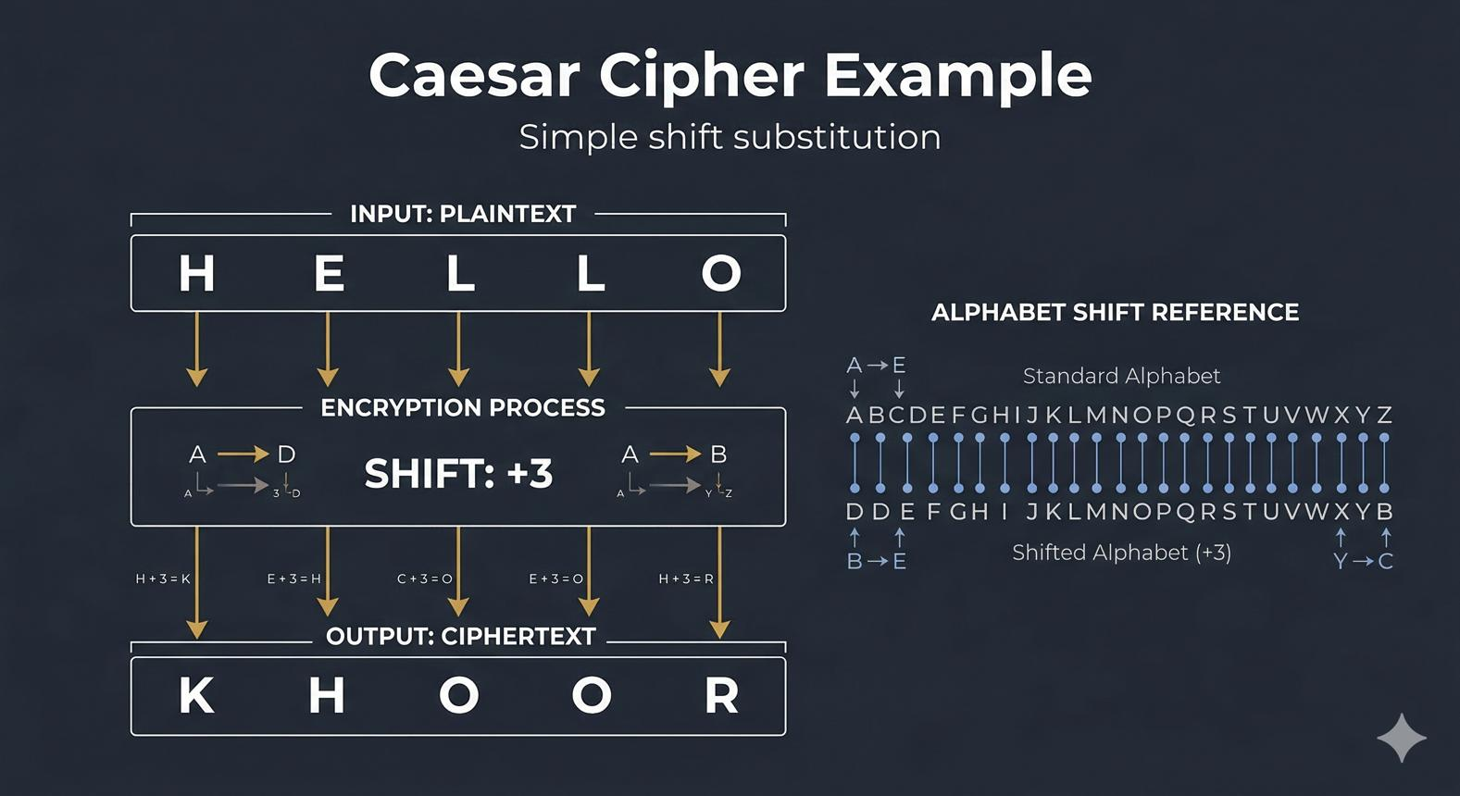
Example
Example: Caesar Cipher
Plaintext: HELLO
Ciphertext: KHOOR
Here, each letter is shifted three positions forward in the alphabet.

Slide 5
What is Steganography?
Steganography is the technique of hiding secret information inside an ordinary file or medium.
The word comes from Greek words meaning “covered writing.”
It focuses on hiding the existence of a message.
Images, audio files, videos, and documents can act as carrier files.
The carrier file contains the hidden information.
The receiver uses the appropriate extraction method to recover the message.
Digital watermarking is one related application of information hiding.
Steganography can be used to help protect copyright and support private communication.
The carrier file should appear normal to an ordinary viewer.
However, file analysis may reveal that hidden information exists.

Slide 6

Example: A digital image containing an embedded text message.

Slide 7
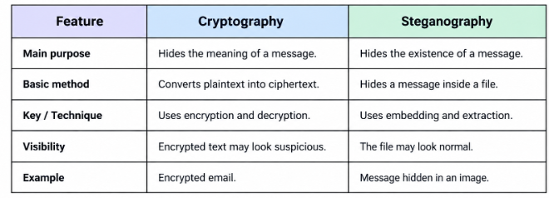
Difference Between Cryptography and Steganography

Slide 8
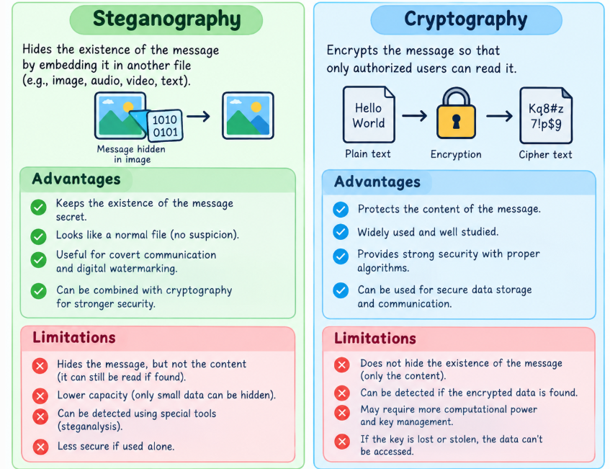
Advantages and Limitations

Slide 9
Conclusion
Cryptography and steganography are important techniques in digital security.
Cryptography protects information by converting readable text into encrypted text.
Steganography hides secret messages inside images, audio, and video files.
Both techniques help maintain privacy and protect sensitive information.
Cryptography mainly hides the meaning of a message.
Steganography mainly hides the existence of a message.
Cryptography uses encryption and decryption to protect data.
Steganography uses embedding and extraction to hide and recover messages.
Both techniques have advantages and limitations depending on their use.
Combining cryptography and steganography can provide an additional layer of protection for digital information.

Slide 10
THANK YOU

